Slide 1
Final Project HPC Presentation
Connor Coleman & Albie Luckas

Slide 2
Gaussian Elimination
Gaussian Elimination works by taking advantage of some definitional properties of the determinant:
Adding a multiple of one row or column to another does not change the determinant of a matrix
The determinant of a diagonal matrix is the product of its diagonal entries.
By repeatedly using a row to zero out one column in the remaining rows, we convert the matrix into a triangular matrix with the same determinant.
The determinant of a triangular matrix is the product of the diagonal elements.

Slide 3
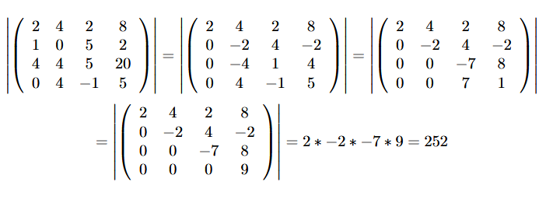
Example Gaussian Elimination

Slide 4
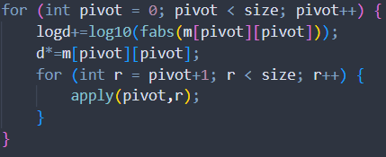
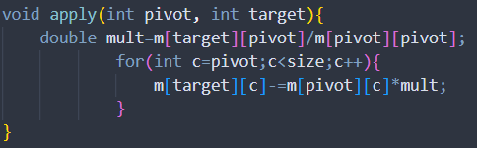
Code - Serial
Nested for loops hit each pair of rows
Apply operation isolated for parallel
Keep running product of determinant
Multiplier constant for row pairs- precompute

Slide 5
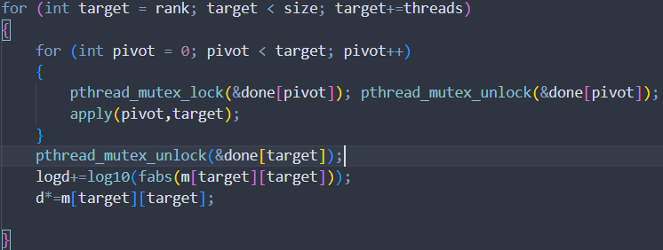
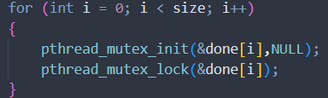
Code - Parallel
Inverted for loop
Mutexes start locked
Lock and unlock to check available
Unlock when done with row
Cyclic distribution

Slide 6
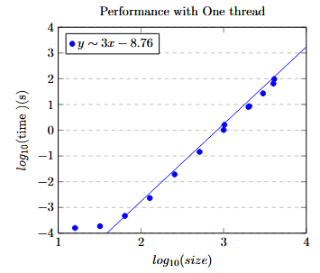
Time - Serial
Double log scale to space out exponentially distributed sizes.
Line of best fit with slope of 3 matches theoretical runtime of O(n^3)
Even without parallelization, only ~ 2 minutes for maximum input
Very little overhead

Slide 7
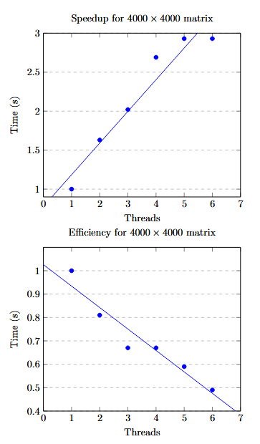
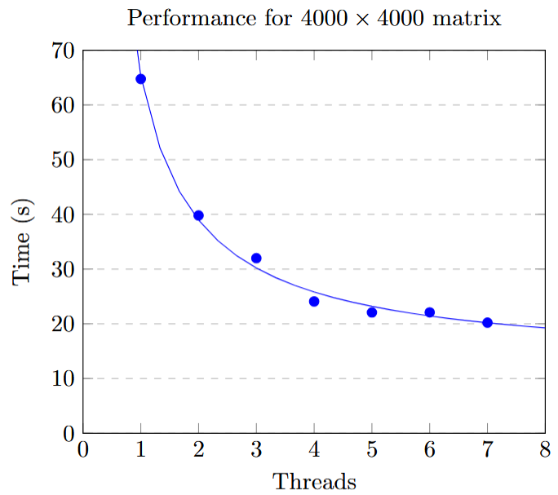
Time - Parallel
Runtime consistent with 12 second overhead
Efficiency decreases with threads, down to ~50% for 6
Speedup of about half the thread count
Outlier speedup for 6

Slide 8
Asynchronous Traveling Salesperson Description
Variation of the classical traveling salesperson problem (TSP)
Travel costs to get from one city to another are not necessarily the same value both ways
A traveler is trying to determine the most efficient route (or tour) to visit every city and end in the city they began in
For the purposes of this assignment, there were 1000 cities, each of which had some travel distance to every other city, making it a complete graph
For this project, the goal was to create and parallelize an algorithm which found the best tour within a time constraint of 60 seconds.

Slide 9
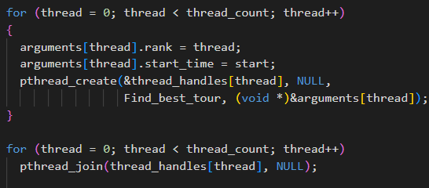
Implementing ATSP
Used a structure to pass both thread rank and start time

Slide 10
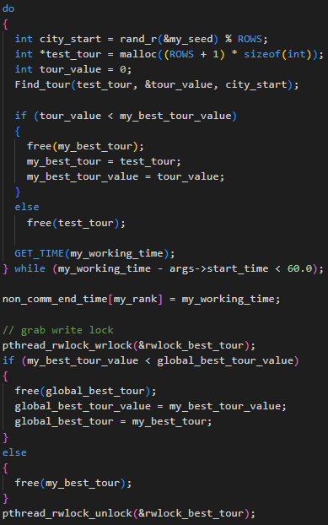
Implementing ATSP (cont.)
Loop through finding tours
Test the found tours against the current local best
Test if the local best is better than the global best
Replace global if so

Slide 11
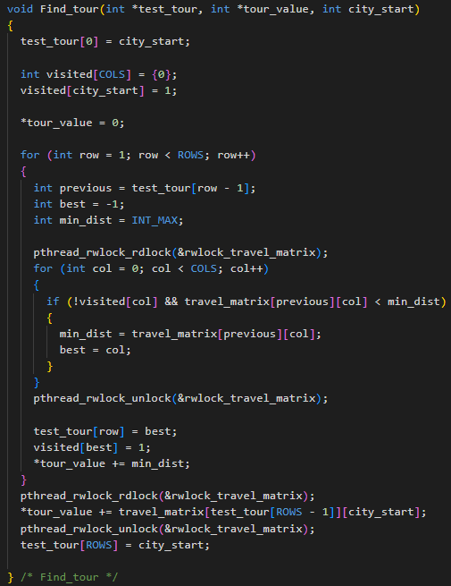
Implementing ATSP (cont.)
Randomly choose a starting city
Loop through the number of cities needed to visit
Loop through non-visited cities
Find the next best travel
“Travel” to the next best
“Travel” back to the start

Slide 12

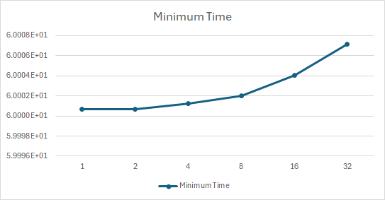
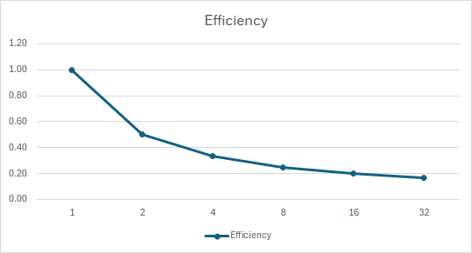
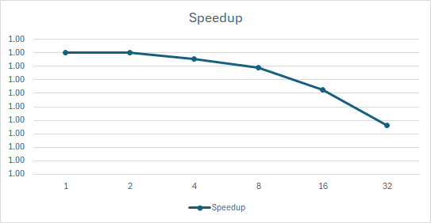
Timing Charts

Slide 13
Interpretation of charts
I don’t think this algorithm can accurately be labeled weakly or strongly scalable since the algorithm runs for a fixed length of time
Constraining a program to run for a fixed length of time and not introducing too many inefficiencies makes the runtime fairly close to fixed!
I was inefficiently using read locks, but after fixing that the timing stayed quite stable

